Slide 1
Techniques for Low-Power Operation

Slide 2
Techniques for Low-Power Operation
Low-power operation is critical in modern electronics, especially in battery-powered devices like mobile phones, IoT sensors, and wearables. Reducing power consumption extends battery life, lowers heat generation, and improves efficiency.
In this lecture, we will explore key techniques used to reduce power consumption in electronic systems, focusing on hardware and software methods.

Slide 3
Key Concepts in Power Consumption
Power (P): The rate at which energy is used by a device.
Formula: P = V × I (Voltage × Current)
In digital systems, power consumption can be broken into:
Dynamic Power: Power consumed when a circuit is switching.
Static Power: Power consumed when the circuit is idle.
Energy (E): The total power consumed over time.
Formula: E = P × t

Slide 4
Techniques for Low-Power Operation
Dynamic Power Reduction Techniques
Static Power Reduction Techniques
Software Techniques for Power Optimization
Low-Power Design Techniques for IoT and Embedded Systems

Slide 5
Dynamic Power Reduction Techniques
Dynamic power is proportional to the frequency of operation and the square of the voltage (P ∝ V² × f). Key techniques for dynamic power reduction include:
a. Voltage Scaling (Dynamic Voltage Scaling - DVS)
b. Clock Gating
c. Power Gating
d. Operand Gating

Slide 6
Voltage Scaling (Dynamic Voltage Scaling - DVS)
Reducing the supply voltage significantly decreases dynamic power since power is proportional to voltage squared.
Dynamic Voltage and Frequency Scaling (DVFS): Dynamically adjusts voltage and frequency based on performance requirements.
Example: Mobile processors throttle down voltage and frequency during idle periods to save power.

Slide 7
Clock Gating
Shuts off the clock signal to inactive parts of the circuit to reduce switching activity.
Effective in reducing dynamic power, especially in large processors with many functional units.
Example: Parts of a CPU (like the ALU) can be gated when not in use.

Slide 8
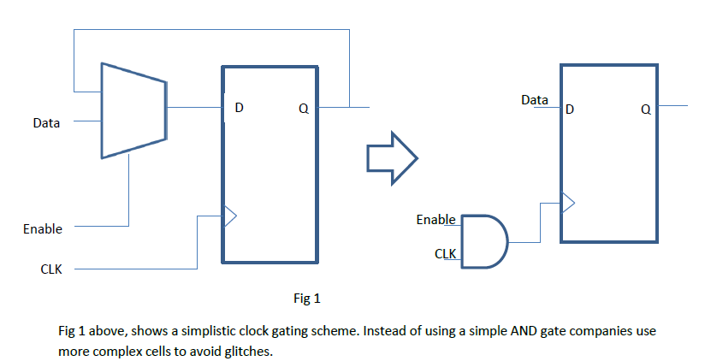
Clock Gating

Slide 9
Power Gating
Shuts off the power supply to inactive circuits, reducing both dynamic and static power.
Power gating typically introduces some delay (wake-up time) when turning back on.
Example: Used in sleep modes for microcontrollers and SoCs.

Slide 10
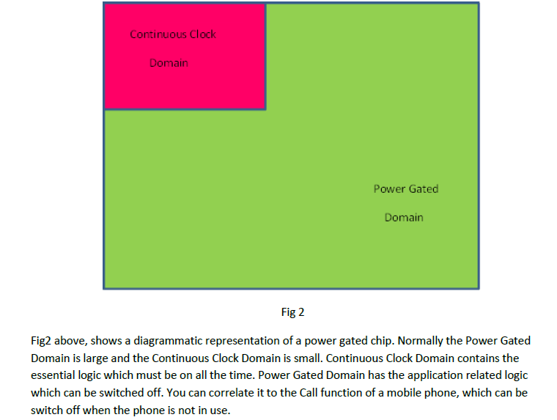
Power Gating

Slide 11
Operand Gating
Reduce switching activity by limiting unnecessary signal transitions in certain blocks.
Example: Arithmetic blocks can skip unnecessary operations when inputs are zero.

Slide 12
Techniques for Low-Power Operation
Dynamic Power Reduction Techniques
Static Power Reduction Techniques
Software Techniques for Power Optimization
Low-Power Design Techniques for IoT and Embedded Systems

Slide 13
Static Power Reduction Techniques
Static power consumption occurs even when no active switching is happening. It primarily results from leakage currents.
Multi-Threshold CMOS (MTCMOS)
Body Biasing
Use of Sleep Transistors

Slide 14
Multi-Threshold CMOS (MTCMOS)
Uses transistors with different threshold voltages in different parts of the circuit to balance performance and leakage.
Low-threshold transistors are fast but leak more, while high-threshold transistors are slower but leak less.

Slide 15
Body Biasing
Modifies the threshold voltage of transistors by applying a bias to the substrate.
Forward body biasing: Reduces threshold voltage to increase speed at the cost of higher leakage.
Reverse body biasing: Increases threshold voltage to reduce leakage, sacrificing speed.

Slide 16
Use of Sleep Transistors
Switches off parts of the circuit during idle periods using transistors to cut the power supply.
Minimizes leakage currents during low-power modes.

Slide 17
Techniques for Low-Power Operation
Dynamic Power Reduction Techniques
Static Power Reduction Techniques
Software Techniques for Power Optimization
Low-Power Design Techniques for IoT and Embedded Systems

Slide 18
Software Techniques for Power Optimization
In addition to hardware-based techniques, software plays a crucial role in reducing power consumption.
Dynamic Power Management (DPM)
Task Scheduling
Adaptive Algorithms

Slide 19
Dynamic Power Management (DPM)
System dynamically changes power states (active, idle, sleep, deep sleep) based on the workload.
Example: CPUs enter idle states (C-states) when the operating system detects low usage.

Slide 20
Task Scheduling
Efficient scheduling of tasks can reduce power consumption by reducing idle times or allowing deeper sleep modes.
Example: A real-time operating system (RTOS) may schedule tasks in a way that maximizes low-power states.

Slide 21
Adaptive Algorithms
Algorithms can be adapted to trade-off between performance and power.
Example: Video codecs may adjust quality dynamically to lower processing requirements and save energy.

Slide 22
Techniques for Low-Power Operation
Dynamic Power Reduction Techniques
Static Power Reduction Techniques
Software Techniques for Power Optimization
Low-Power Design Techniques for IoT and Embedded Systems

Slide 23
Low-Power Design Techniques for IoT and Embedded Systems
Duty Cycling: Periodically turns the system on and off to save power.
Energy Harvesting: Collects ambient energy (e.g., solar, vibration) to supplement or replace battery power.
Low-Power Wireless Communication: Technologies like BLE (Bluetooth Low Energy) and Zigbee are designed for low-power communication.

